Slide 1


DESIGN 1
Lesson 3: Independent Application: Contact Times Table
Ms. Abboud • Grade 9 - Design 1 • Term 1, Week 8

Slide 2
Learning Objectives
WALT - We Are Learning To
WILF - What I'm Looking For
Plan and build a table on your own.
Use colspan to make a title row.
The table holds real tabular data (days and times).
The table is structurally correct and displays cleanly.

Slide 3
Academic Vocabulary
Colspan
An attribute on a table cell that makes it stretch across (merge with) multiple columns.

Slide 4
Frayer Model: Colspan
DEFINITION
CHARACTERISTICS
An attribute on a table cell that makes it stretch across (merge with) multiple columns.
An attribute on <td>/<th>; merges cells sideways; takes a number.
COLSPAN
EXAMPLES
NON-EXAMPLES
<th colspan="2">Contact Times</th> spanning 2 columns.
rowspan (merges vertically, not sideways).

Slide 5
National Identity Integration
UAE Statistical Information: the UAE publishes official data in clear tables so people can compare facts quickly. This week your F1 website presents real data, including facts about the Abu Dhabi Grand Prix.

Slide 6
STARTER
Table or List?
Look at your Contact Us page.
What information would be clearer as a table than as a list?
Hook • Engage & Ask
5 - 10 minutes

Slide 7
LESSON CORE
I Do: The Title Row
Plan first: how many columns and rows?
colspan="2" makes one cell stretch across both columns.
Gradual Release of Responsibility
30 - 40 minutes
Stretch: a title row across 2 columns
<tr>
<th colspan="2">Contact Times</th>
</tr>
1 / 2

Slide 8
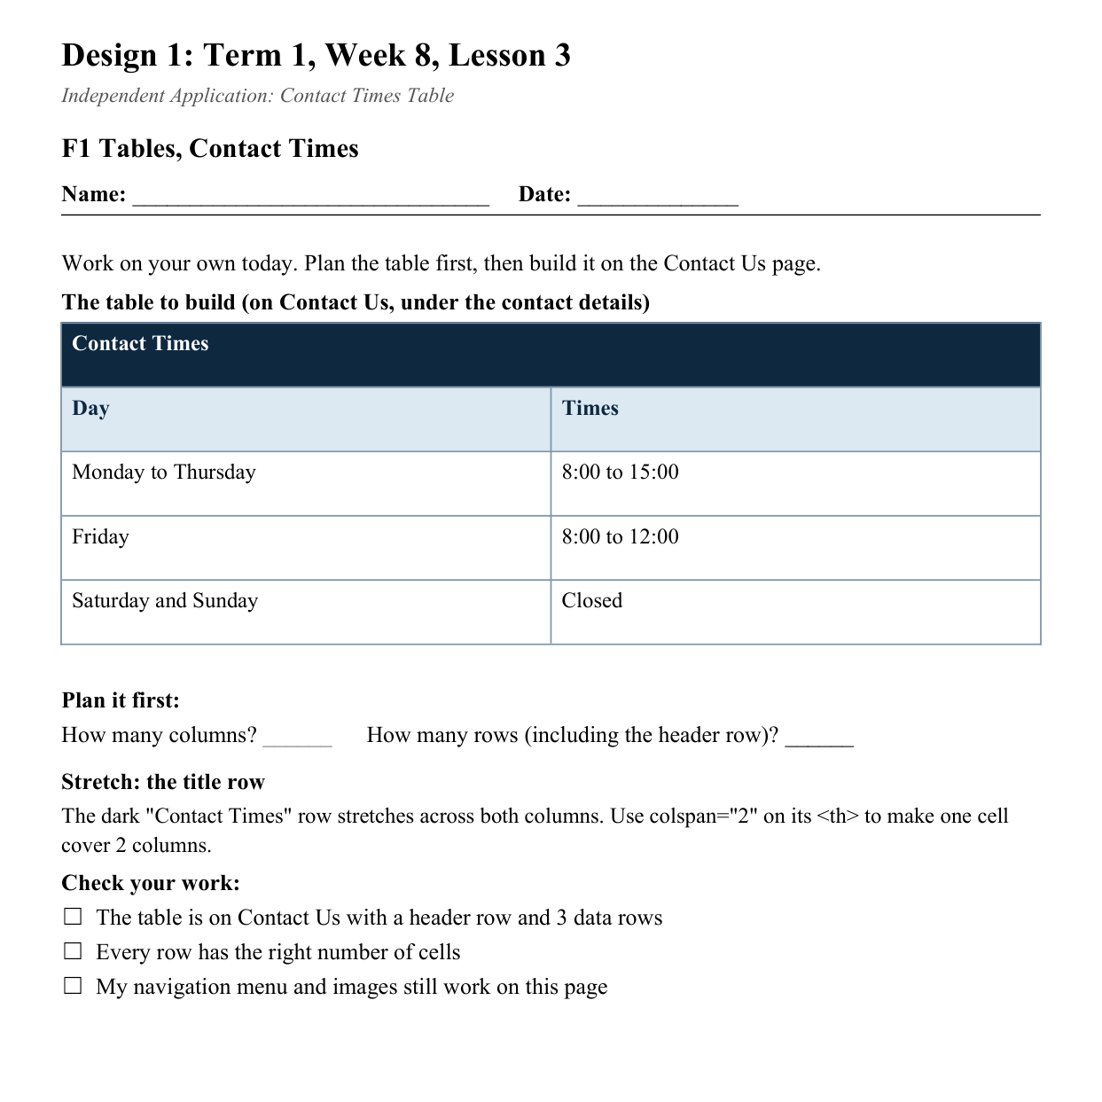
LESSON CORE
You Do: Contact Times
Build the Contact Times table on Contact Us, on your own.
Check every row has the right number of cells.
Activity: F1 Tables, Contact Times
Gradual Release of Responsibility
30 - 40 minutes
2 / 2

Slide 9
CLOSURE
Teacher Circulation
No formal exit ticket today. Teacher circulates for 1:1 support.
Transition & Extend
5 - 10 minutes

